Slide 1
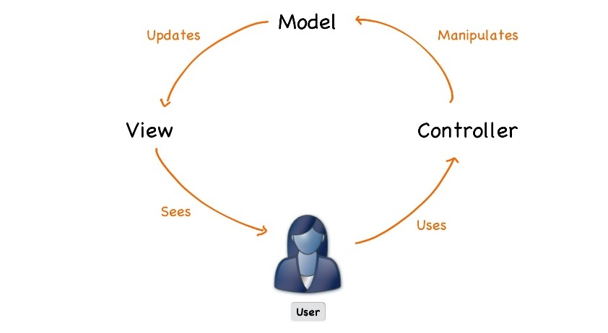



ASP.NET Core
Course Introduction
SoftUni Team
Technical Trainers
Software University
http://softuni.bg

Slide 2
Table of Content
Course Objectives
Training and Team
Course Organization
Course Infrastructure
Evaluation Criteria
Resources

Slide 3

Course Objectives

Slide 4
ASP.NET Core Course Content (1)
Essentials of ASP.NET Core
Application Flow, Filters and Middleware
Web API
Security and Identity
Unit Testing
Project Architecture
ML.NET
Azure, Deployment and Continuous Integration

Slide 5
Exam - Project Defense
Implementing a web application with:
.Net Core 3.1
Public defense of its work in front of a trainer
10 – 15 minutes
Demonstrate how the app works (very short)
Show the source code and explain how it works
Answer questions related to the project

Slide 6


The Module Team

Slide 7
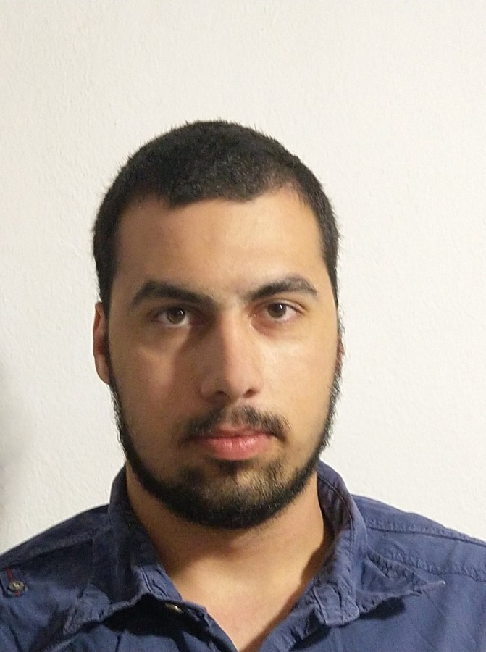
Module Team (Trainers)
Dimiatar Kolev
5+ years in the IT
Developer

Slide 8

Course Organization

Slide 9
ASP.NET Core Course – Timeline
23-Sept-2020
12-May-2020
ASP.NET Core
30 weeks * 2 times / week
Start: 23-Sept-2020

Slide 10

Homework Assignments & Exercises
Your homework is mainly work in class
Lesson days → slides + live demos + exercises
Exercise days → only exercises
Do your homework when it's due
Assignments pile up quickly

Slide 11



Course Web Site, Forum and FB Group
Official web site:
Official discussion forum:
Official Facebook groups:
https://softuni.bg/trainings/2354/aspnet-core-july-2019
https://softuni.bg/forum/categories/31/csharp-mvc-frameworks-asp-net
https://www.facebook.com/groups/CSharpWebMay2019/

Slide 12

Resources
Resources
What We Need Additionally?

Slide 13
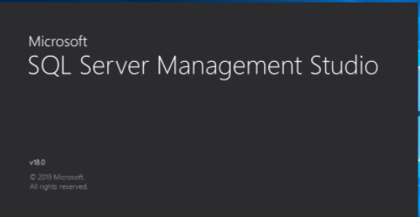



Required Software
Software needed for this course:
Microsoft Windows (Win 10 / 8.1 / Win8 / Win7) or Mac or Linux
Visual Studio 2019

Slide 14
https://softuni.bg/trainings/courses

